Slide 1
Week 5 Presentation
Espruino Tools

Slide 2
Progress
Over the last week I have
Figured out previous issues with puck and resolved them.
Overhauled UART to allow for custom modal designing.
Added a close button to UART connection modal.
Implemented method to gather functions on device and call on them.
Investigated BLE controls

Slide 3
Problems
Active
HDE plugins do not seem to have a clean easy way of implementing as devices need to restart to allow functionality to work, on top of this Ive not been able to get this working at all.
Resolved
UART modal had issues which required UART refactoring to fix, as a side affect we now can tell if eval calls are successful.

Slide 4
Decisions Made?
Not many this week.
Addition of JSS to UART

Slide 5
JSS
Jss also known as cssinjs is a package wich allows for style sheets to be constructed and implemented using javascript.
WHY
This allows us to easily overwrite this styling using a standard css file, meaning there is additional control by the end developer to mess with the modals design.
This avoided embedding and worrying about bringing an external css sheet into the npm package.

Slide 6
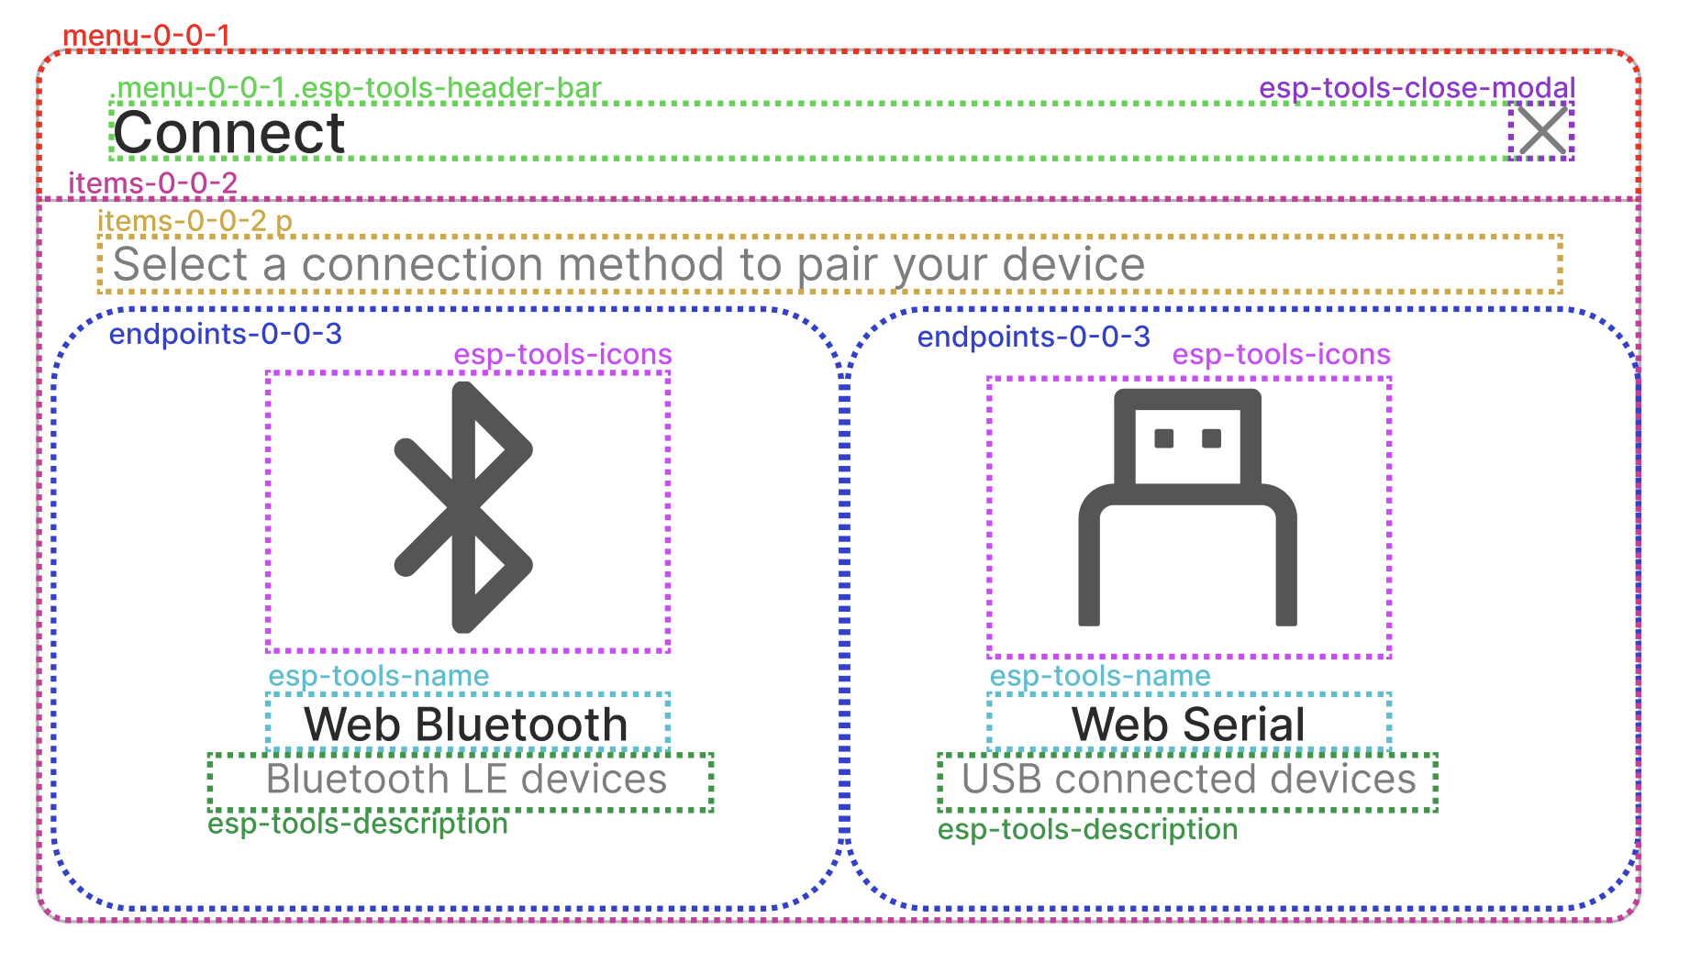
Minor Plans
Styling guide on documentation
If time permits, additional default modal designs.

Slide 7
Whats Next?
Implement relevant device specific methods to ease development time
Fix issue with onPress
Implement NPX tool
Create Demos to display ease of functionality using new package.
Populate documentation.
Investigate relevance, need to implement IDE

